Slide 1
Git’er Done
Octocat is dumb
I hate computers
But git is good so use it

Slide 2
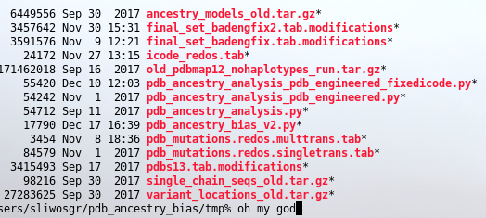
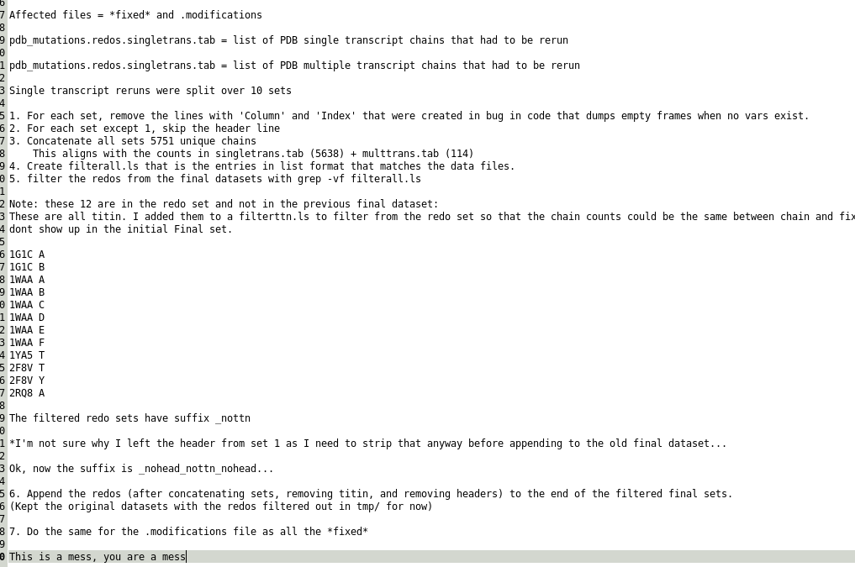
My life in the Capra lab
Multiple input datasets
Tons of script versions and bug-fixes
Old output files
Long README about how different output versions were merged

Slide 3



My life in the Meiler lab…
Hey Greg model these loops now! No more excuses!
Sure Jens no problem I love modeling protein loops!

Slide 4


My life in the Meiler lab chapter 2
Hahahaha someone refactored loop building and it doesn’t care about your stupid disulfide bond hahahahahhaah EAT IT
This loop has a disulfide bond!

Slide 5
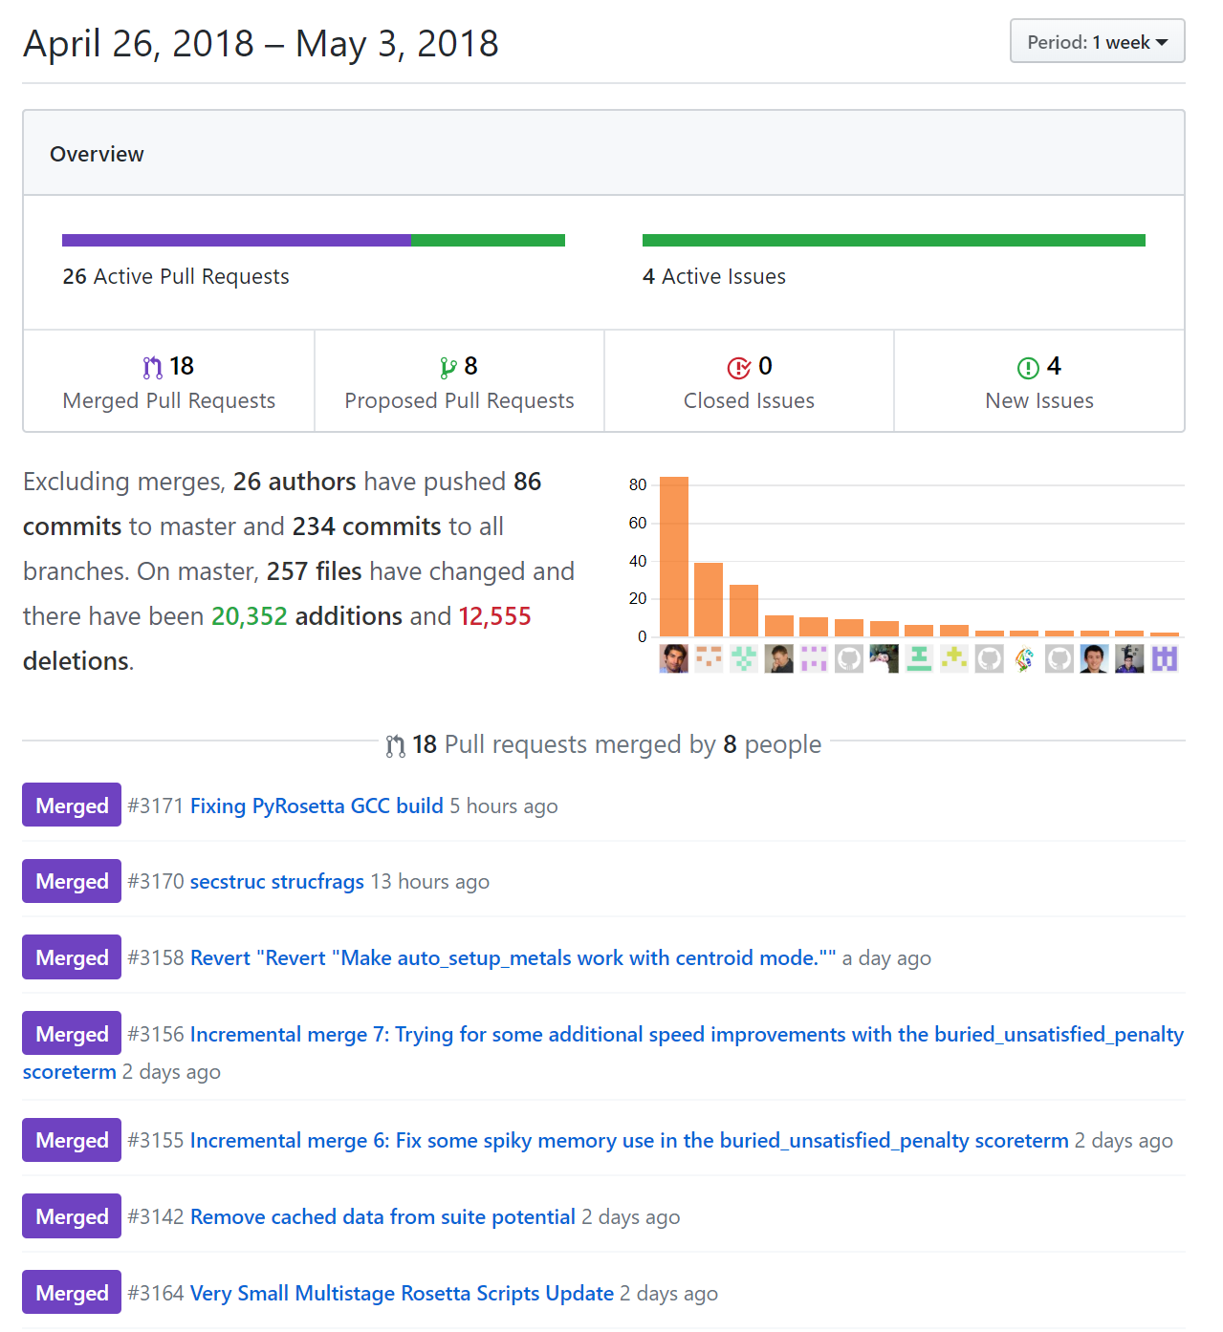
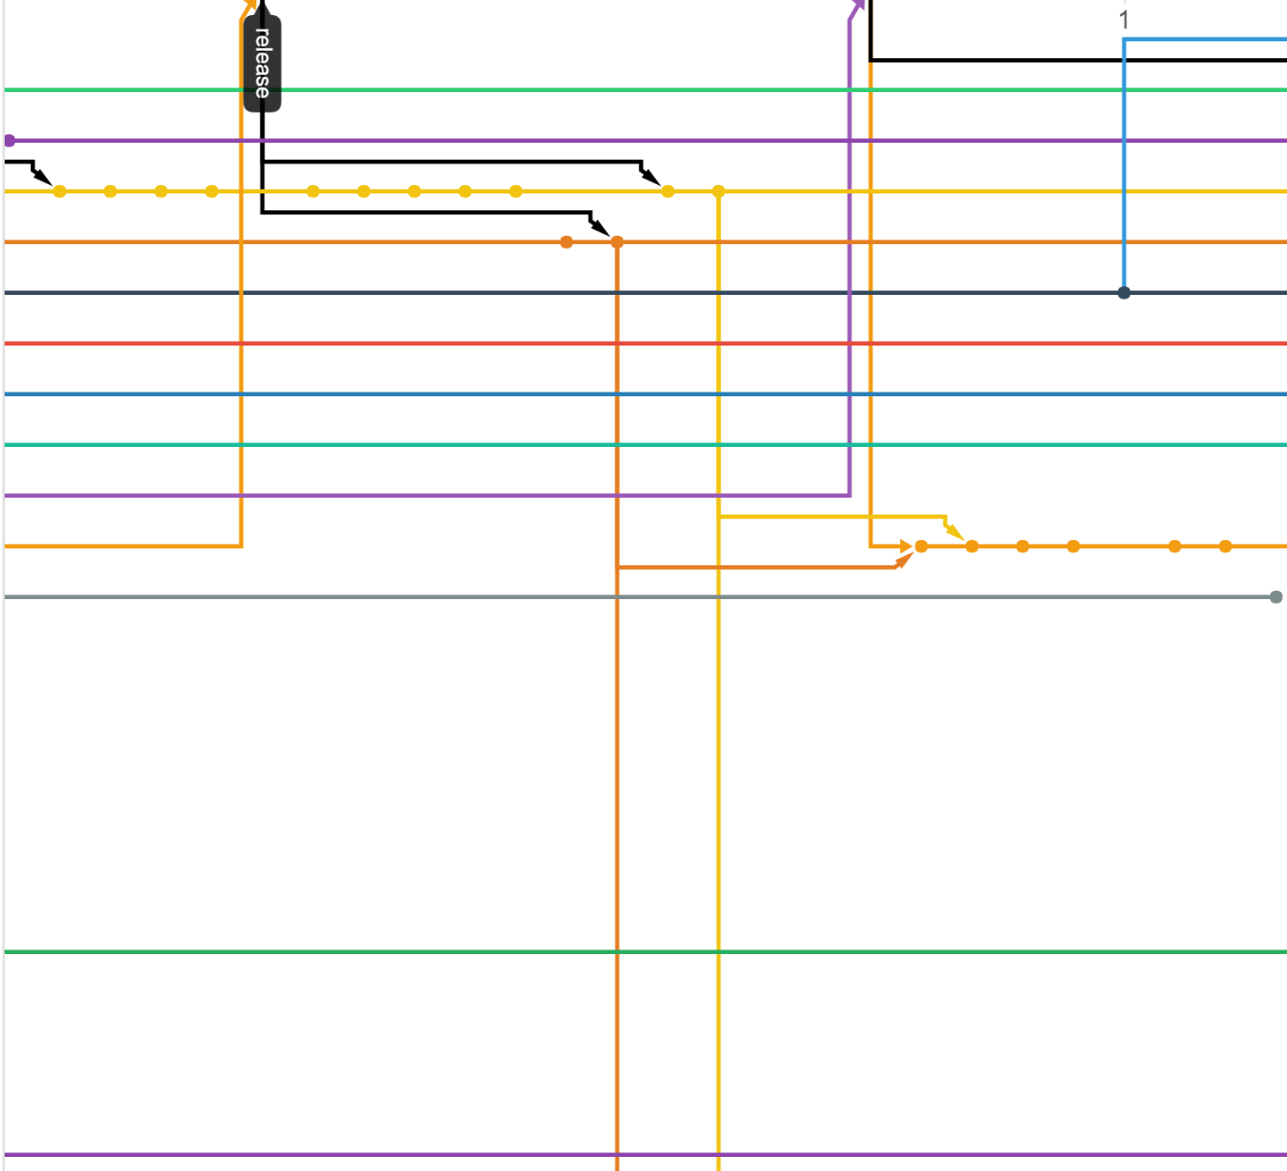
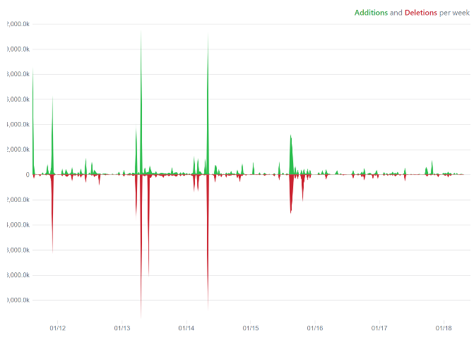
I like fixing code it’s… OH MY GOD
1 week

Slide 6
Git Bisect is magic
Tell Git that version 1.0 works (begin)
Tell Git your current version is broken (end)
Magically, you are teleported to the working directory midway between
Compile and test
Tell Git it works!
Magically you are now ¾ between
Repeat 30000 times
Find yourself in identical working directory of bad programmer
Git tells you exactly what changed before and after

Slide 7
How to fake being a programmer
Use git bisect
Identify 1 line of code that broke some feature years ago
Change that line of code
Compile
Show people you fixed something in Rosetta
Accolades

Slide 8

What is git? (and github?)
Being a genius is fun you should try it sometime oh wait you can’t
ha ha
The most commonly used version control system (VCS)
A historian
No more _fixed, _fixed2, _fixed2_final, _fixed2_final_realfinal
A multitasker
Work on multiple things at once with ease
A cloud
Share your code, get code from others, backup code
Everything is easier. Everything you already do is easier.
Git was made by this guy (in 2005)
Yeah he made linux too.
But he didn’t make github because he’s lazy
Something to put on your resume
Git
GitHub
Linus Torvalds

Slide 9
What is a Git?
Quoting Linus: "I'm an egotistical bastard, and I name all my projects after myself. First 'Linux', now 'Git'".
('git' is British slang for "pig headed, think they are always correct, argumentative").
What Git stands for (according to Linus)
"Global information tracker": you're in a good mood, and it actually works for you. Angels sing and light suddenly fills the room.
"Goddamn idiotic truckload of sh*t": when it breaks
The original description
This is a stupid (but extremely fast) directory content manager. It doesn't do a whole lot, but what it does do is track directory contents efficiently. It is intended to be the base of an efficient, distributed source code management system. This package includes rudimentary tools that can be used as a SCM, but you should look elsewhere for tools for ordinary humans layered on top of this.
Today’s description
Git is a fast, scalable, distributed revision control system with an unusually rich command set that provides both high-level operations and full access to internals.

Slide 10
Version Control (VCS)
Keep track of every modification
Go back in time easily
Less clutter
Keeping notes is built in Science says this is important
Anyone can see what decisions you made and why you made them (my future self is stranger danger)
Independent work
No file locking nonsense
Parallel testing and development
Experiment without clutter or interruption
Security
Cryptographic keys

Slide 11
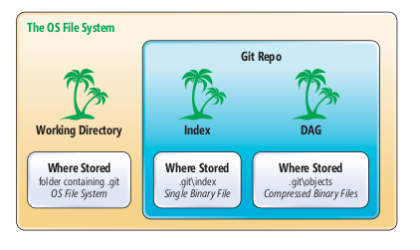
Git – a forest with 3 trees
The three trees of Git
Virtual storage of project’s entire history – the gits
repo = project repository
This is CRITICAL INFORMATION (not the trees part, that’s dumb)

Slide 12
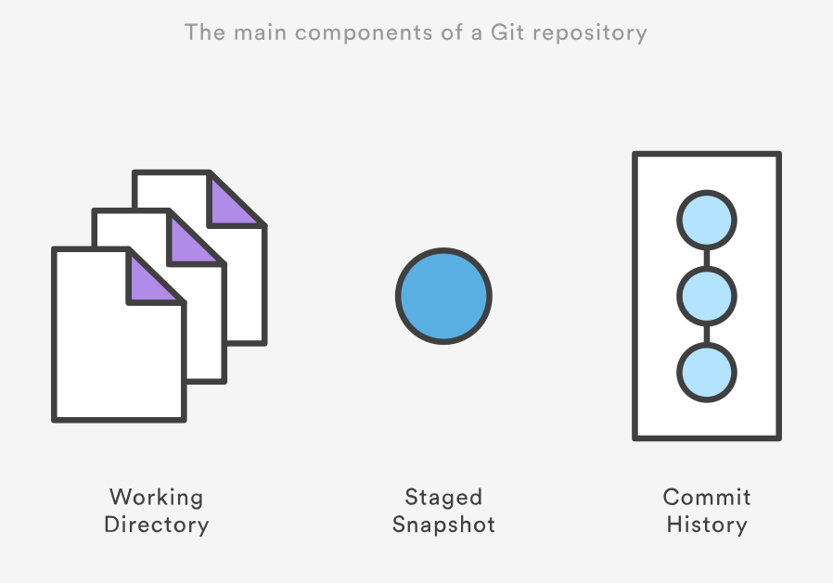
Tree: the working directory (Editing)
In sync with the file system
gedit, Microsoft Word, vim, emacs^{(but why?)}
Where you work
Put your datasets
Program your scripts
Get your output

Slide 13
Tree 2: The Index (Staging)
Stage changes for committing to history
A buffer between active work and your work’s history
Uses an internal caching mechanism
The place where you select what goes into a commit

Slide 14
Tree 3: History(Committing)
Directed acyclic graph (DAG)
Full commit history
Permanent (mostly) snapshots of staged changes every time you commit them
Combination of delta encoding and compression

Slide 15
The Basic Git Workflow (Being Tarzan)
Edit – edit files in your working directory
Stage – add those changes to the staging index, putting together your next commit
Commit – take a snapshot of your collected changes (stage) and add it to your project’s official history

Slide 16

Getting starting
git init – create a new repo
Can run inside empty directory
Or create a new directory
git init <new_directory>
Or inside a project you’ve already started
*Nothing you’ve done is changed, you just can start being cool now
The .git directory is created inside the folder which contains all the necessary metadata used by git. That’s all it does when you run git init.
There’s no admin privileges nonsense, it’s just creating a new set of directories and files inside your project.
Running git init again won’t do anything (used for moving .git and getting new templates, but we don’t cover that)

Slide 17
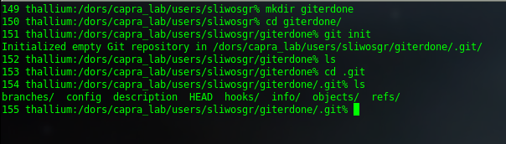


Slide 18
A Git iteration
1. Edit: If you don’t know how to edit a file then go home
2. Stage
3. Commit

Slide 19
2. Stage
git add <filename>
Adds a change in the working directory to the staging area
Must specify something to stage
. = Add everything
useful if you git init in a project already started
<dir> = Add a directory
-p = Interactive, select which chunks of changes to add
Doesn’t alter your working directory or record anything in history
Must be repeated every time you edit

Slide 20
Check the state of the working dir and stash
git status
Shows which changes have been staged and which haven’t
Lists untracked files: files that have never been staged or committed
Does not show any history
Good practice to check before running commit
Commits are snapshots in time
‘Atomize’ your progress. Commit units of change.

Slide 21
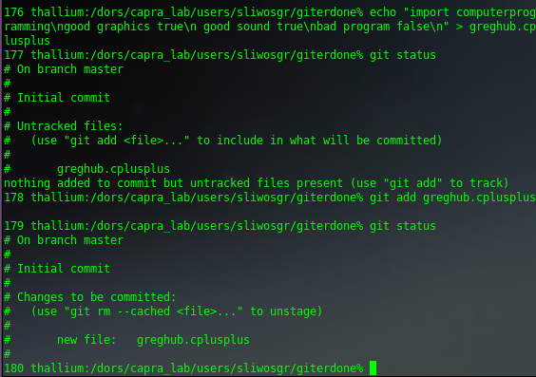
Stage the first commit
Write a program
Nothing staged yet
Stage the new program
Wow there it is go figure

Slide 22
3. Commit
git commit
Commit the current stage to history
Hitting ‘save’
Permanent unless you explicitly tell git to change your history
still permanent but in a secret place
Refreshes staging index
Doesn’t change anything in working directory
Asks for a commit message
Essentially advances the current branch one snapshot.
Each commit is a core building block of project history
Note: if working on a public repo (from Github) this doesn’t change the Github version, just your local one

Slide 23



The commit message
lol I don’t do commit messages
History of life
By Greg Sliwoski
Critical
Critical
Critical
Common practice:
Line 1 = short summary (50 char or less)
Line 2 = blank
Line 3+ = All changes detailed
git commit –m “shortcut to supply message to command line”
Otherwise git will open default text editor (can be changed)

Slide 24
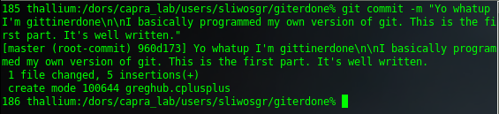
Let’s commit this sucker

Slide 25
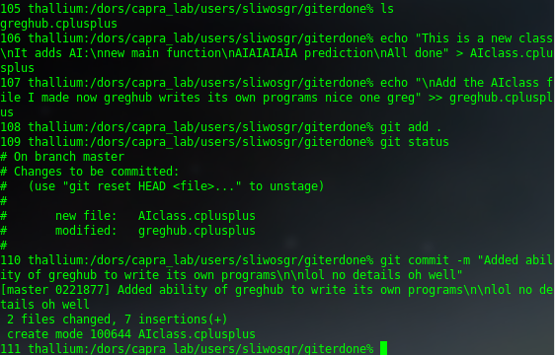
Let’s add some more stuff to my program
Add new class for AI
Stage it
Commit AI

Slide 26

You can now put git on your resume
And technically be correct
Wrote greghub
Added AI to greghub
The giterdone repo
Your working directory is here
But let’s learn how to use git for real

Slide 27
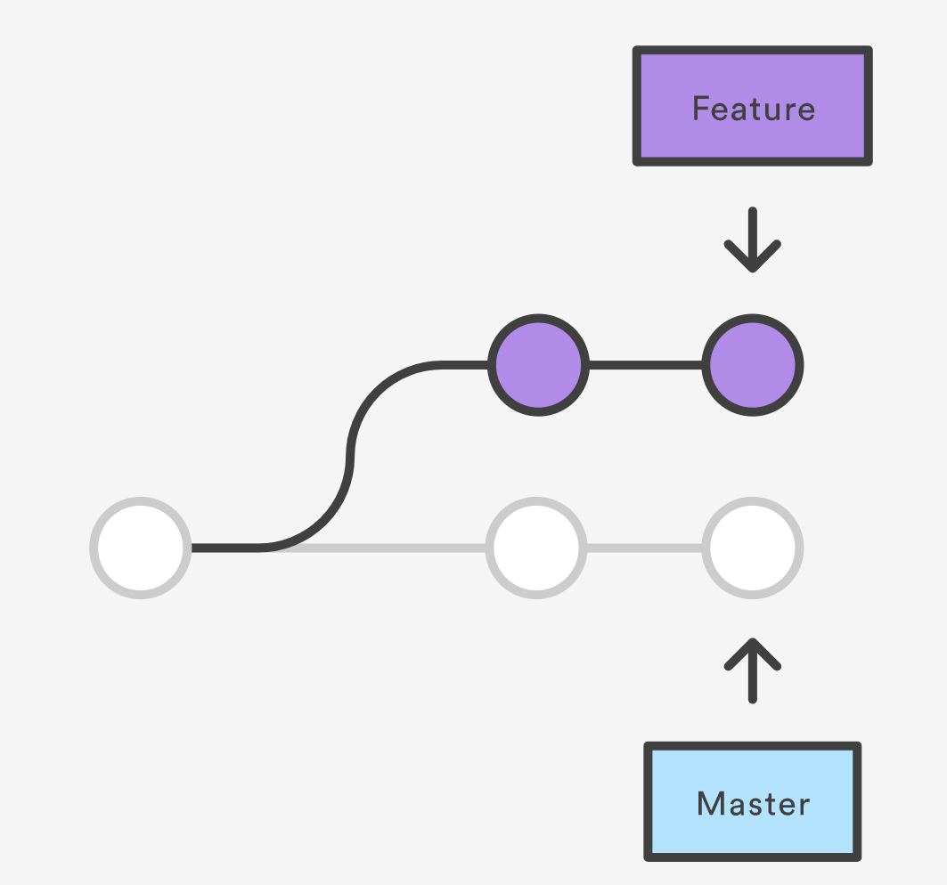
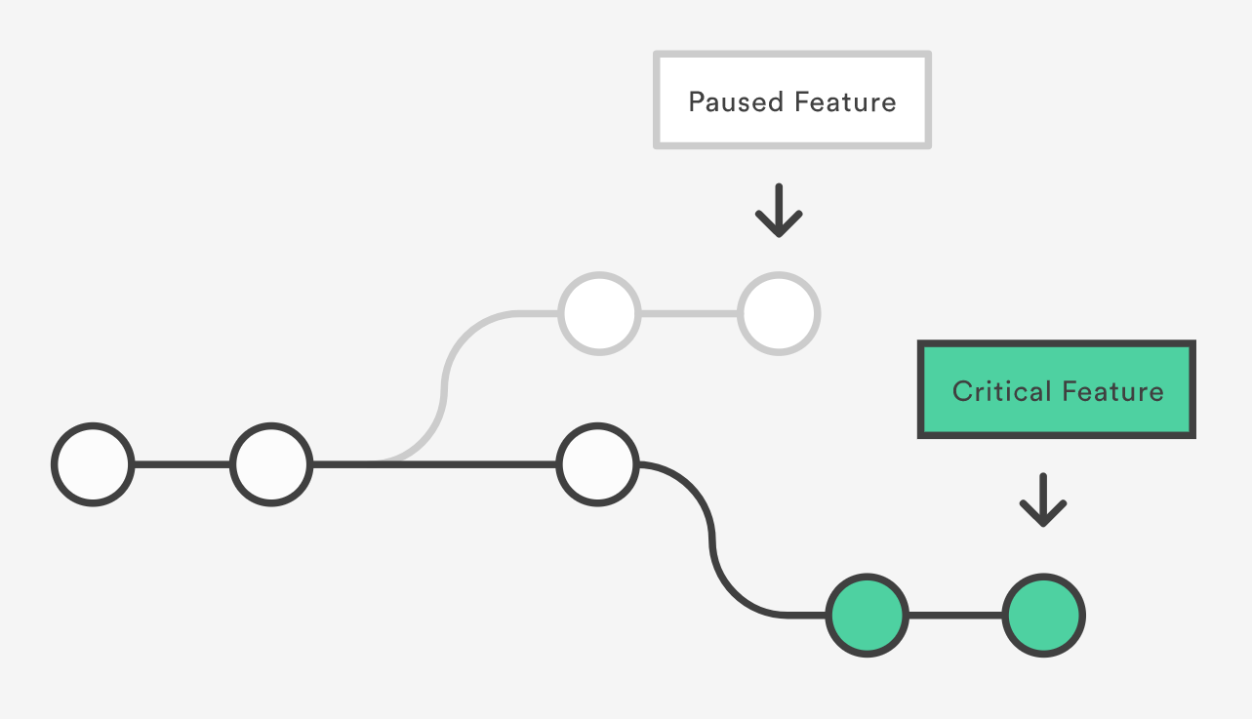
Not just a record keeper: Git Branches
Branches are natural (look at trees they branch)
The git branch creed:
thy new task
whether tis Jupiter or Mercury
you start a new damn branch
Branches are isolated working environments
Flexibility – no more commenting out unfinished code
Play around – whatever you do on a branch doesn’t change master (commit nonsense for all I care)
The master branch is production quality at all times
Where you started
You were already using branches and didn’t even know it

Slide 28
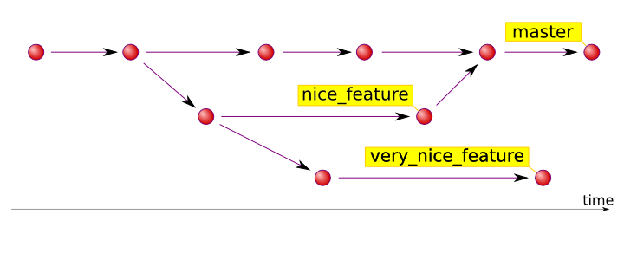
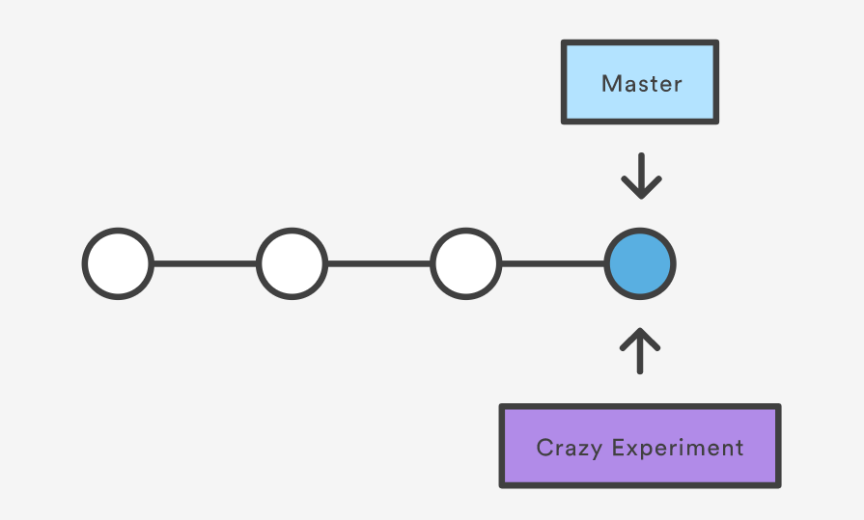
Branching
git branch <new_feature>
Creates a new branch but doesn’t move to it (makes no changes)
git branch = list all branches
-d = delete (will not delete unmerged changes, -D to force delete)
-m <new_name> = renames current branch
You are always on a branch
git status shows which one
Every time you commit it adds to the branch you are on
Branches are lightweight
Creating a branch simply creates a new pointer to your current commit
Nothing in repo changes
A branch is just the tip of a set of commits

Slide 29
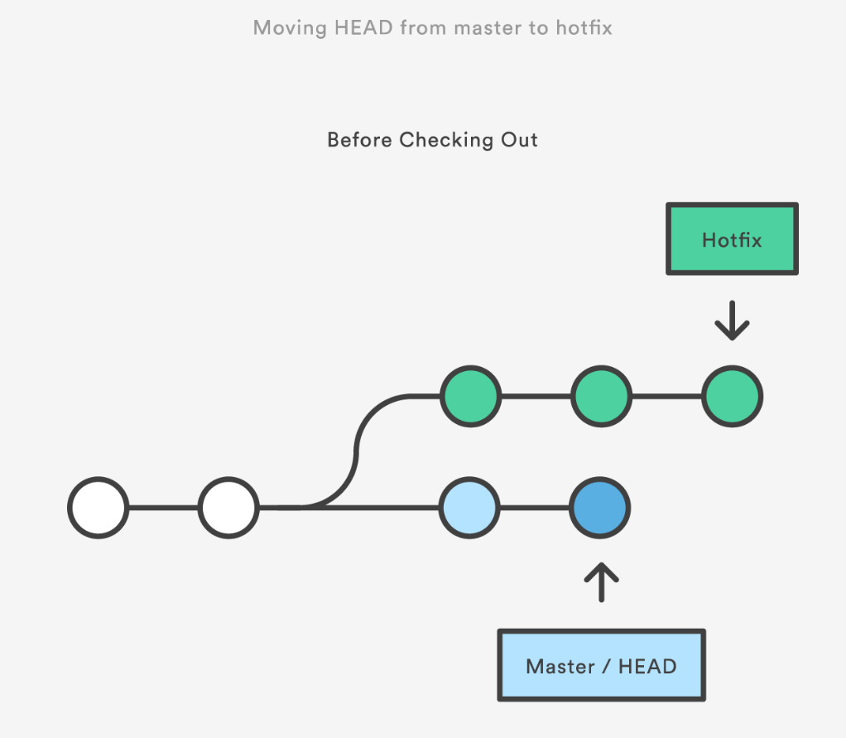
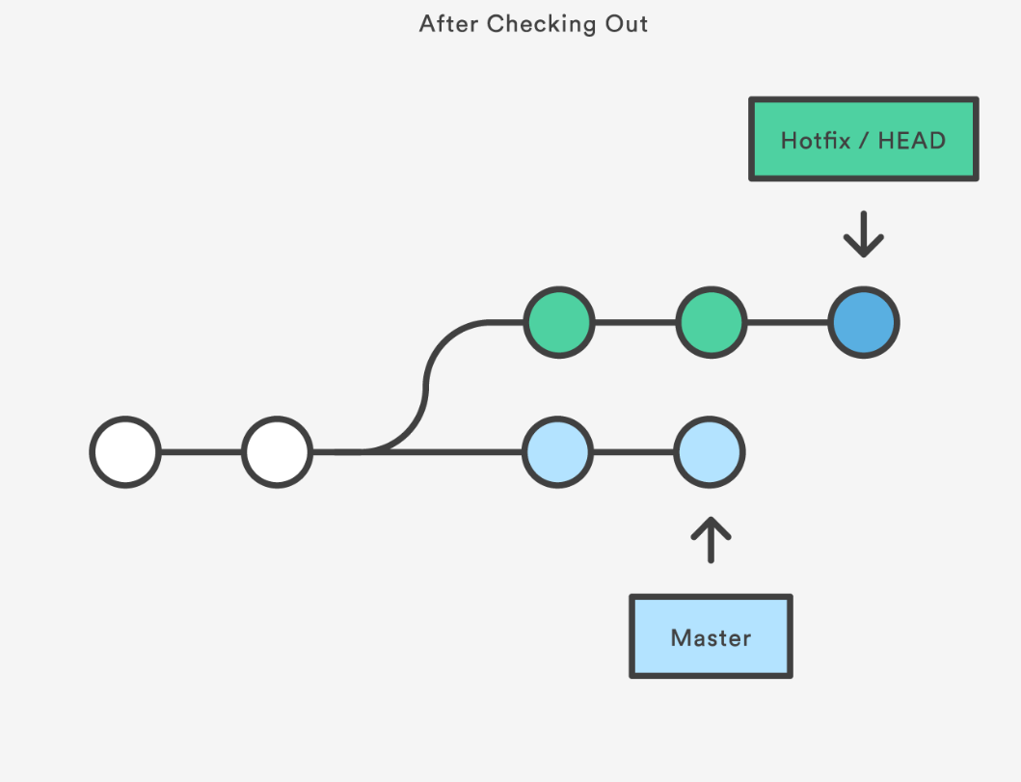
Branch jumping
If you’re on master, and you create a new branch, you do not move to it, any further commits attach to master.
git checkout new_feature = go to the new branch
Alternatively, create a new branch and move right to it
git checkout –b feature2
Then you can switch back to master: git checkout master
And delete the branch: git branch –d feature2
git checkout Hotfix

Slide 30
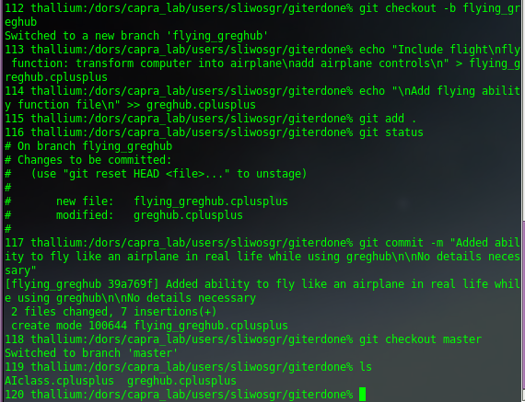
Let’s improve greghub the right way
Create a new branch for the flight feature instead of just adding to master (in case I mess up which is unlikely but people are already using greghub so I gotta do this right plus I should warn people before they start flying)
I added flight to this branch, but nothing on master has changed!
See no flying_greghub on master

Slide 31
giterdone is a legit git repo now
Added ability to fly with greghub
flying_greghub
Wrote greghub
Added AI to greghub
The giterdone repo
master
Any commits will add here
The working directory is here since I moved back to master

Slide 32
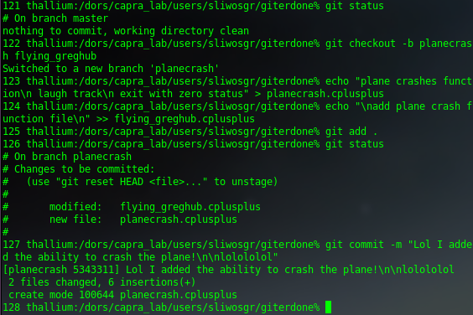
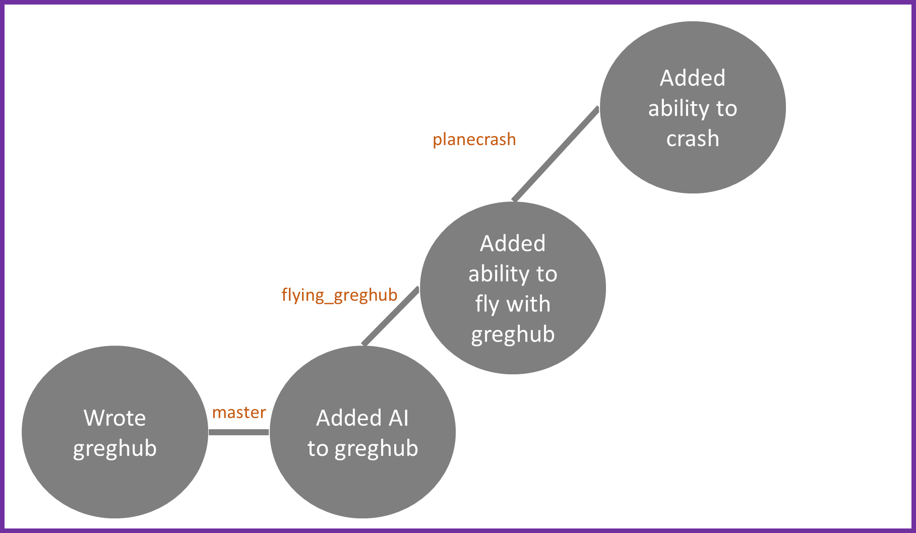
Add to any branch from anywhere
git checkout –b <new_branchname> <source_branch>
Any commits add here

Slide 33
The Art of the Move
git checkout – moving around a git repo (not just branches)
Instantly change your entire workspace (or individual file) to reflect any state in time or branch
Since this can lose local changes, git forces you to stash or commit changes in working directory that would be lost
Not to be confused with git clone (fetches a remote repo and puts you in it)
Internally, all git checkout does is:
Alter HEAD to point to your new location
what is HEAD?
Change your working directory to match that new location
Specifying a branch name moves HEAD to the last commit of that branch
Specifying a file replaces just that file in your working directory
You can move to any specified commit but it results in a detached head state
What’s a detached head state and how do you specify commits directly?

Slide 34
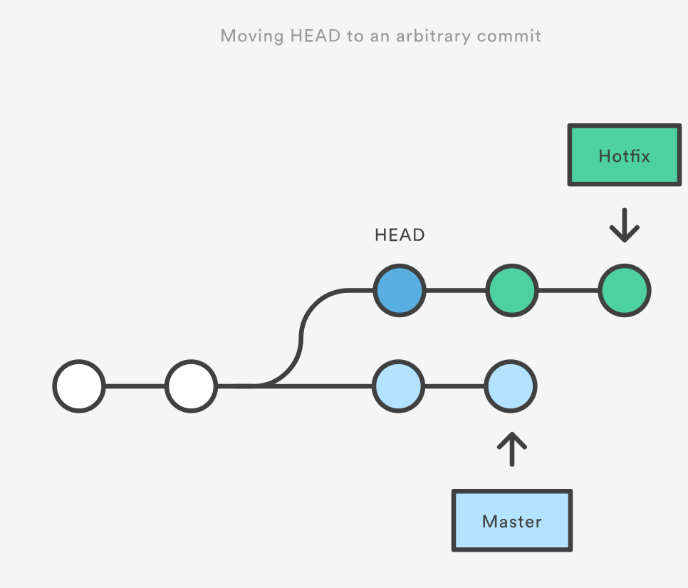
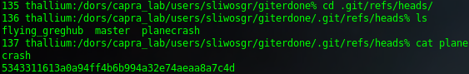
Individual commits: ID or ref
All commits have unique SHA1 ID (reported after commit)
refs are convenience aliases for commits
Branch names are special refs to the last commit in that branch
HEAD is just a special ref
You don’t need to specify the full ref name
relative refs: use ~n (ex: HEAD~2 = grandparent of HEAD)
refs are Stored as normal text files in .git/refs
.git/refs/heads/ = all local branches in repo
each filename is a branch and inside is the commit hash at the tip of that branch
To change location of master branch, git just changes contents of refs/heads/master file
Creating a new branch just writes a commit hash to a new file
Garbage collection routinely compresses refs into a single file for efficiency.
if refs dir is empty that’s where they went

Slide 35
Tags
git tag <tagname>
ref that points to specific points in git history
Represent read-only branch
Typically used to mark version release
By default tags whatever HEAD currently points to
git tag = list tags
git tag –d <tagname> = delete a tag
git checkout <tagname> = go to a tag (causes detached HEAD state)
Types of tags
Lightweight: bookmarks to a commit (usually private)
Annotated: stores meta data such as tagger name, date, a message (usually public)
git tag –a v1.4 –m “Version 1.4”

Slide 36
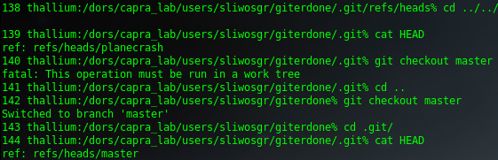
Special refs
Found in top level .git directory
HEAD = currently checked-out commit/branch
For the most part, HEAD is the only reference you’ll be using directly
ORIG_HEAD = backup ref to HEAD before drastic changes to it
MERGE_HEAD = commit(s) that you’re merging into the current branch with git merge.
FETCH_HEAD = most recently fetched branch
running git pull runs git fetch which updates FETCH_HEAD and runs git merge FETCH_HEAD

Slide 37
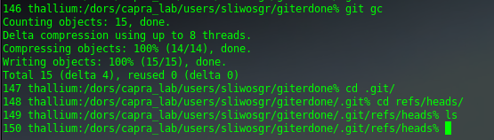
Garbage collection
By default runs every 90 days
Cleans up orphaned commits and compresses stuff
Can invoke with `git gc`
Watch my refs vanish (they got combined into one file):

Slide 38

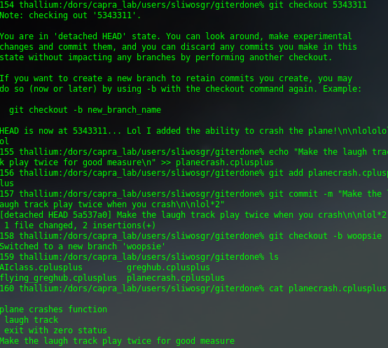
Detached HEAD State
HEAD should point to a branch name
branch name is just a special ref to last commit in branch
HEAD can point to any snapshot in history (it’s just a file with an ID in it)
When HEAD doesn’t point to a branch ref, you’re in a detached HEAD state
checkout a tag (tags are read-only branches) (git checkout v1.0)
checkout a specific commit ID (git checkout 5343311)
checkout a relative (git checkout HEAD~2)
Any commits to a detached HEAD state are orphaned
Have no associated branch
Will be removed by garbage collection
Creating a branch from a detached HEAD will make it all good!

Slide 39
Putting things back together
git merge <source_branch>
Add all the commits from one branch to another
Combine independent lines of creation
Add finished features to master
Merges INTO current branch (source_branch is completely unaffected)
Merge into a different branch than the current one with git merge <dest> <source>
Typical workflow after finishing feature:
git checkout master
git merge feature_branch
git branch –d feature_branch (delete the old feature_branch since it’s now part of master)
Protip: commit any changes in your working dir before you run a merge

Slide 40
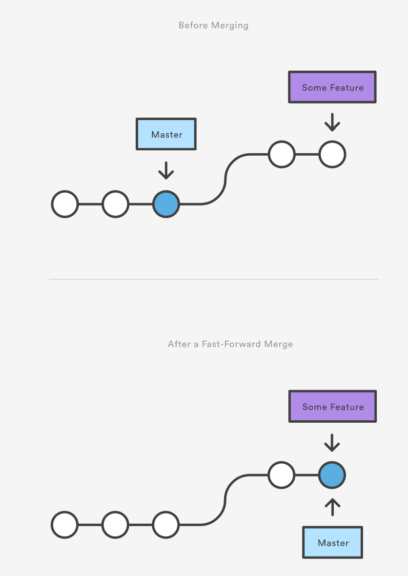
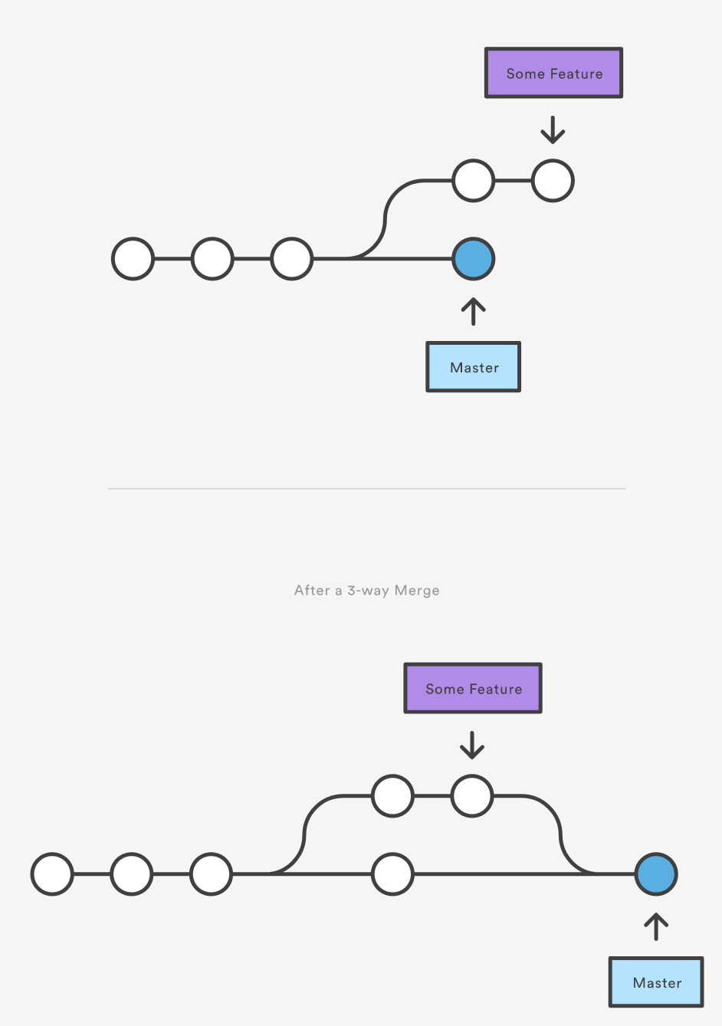
2 Types of merge
Fast-forward merge (ff)
Simple linear merge
Does not create new commit (--no-ff to force it to)
Essentially just moves HEAD to point to very last commit of other branch and straightens into one branch
Looks like you never created a branch in the first place
2. 3-way merge
When branches have diverged
Generates a merge commit
May require conflict resolution
--ff-only = only merge if current HEAD is up to date or merge can resolve as ff.

Slide 41
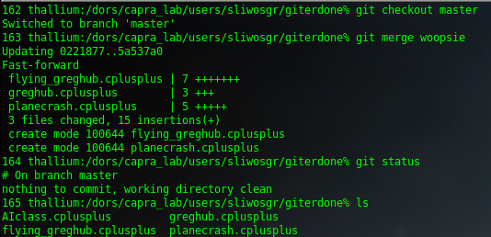
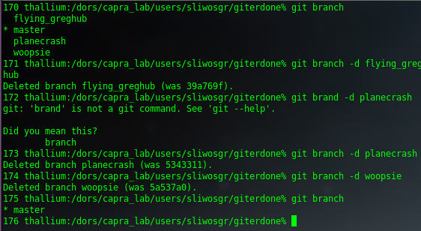
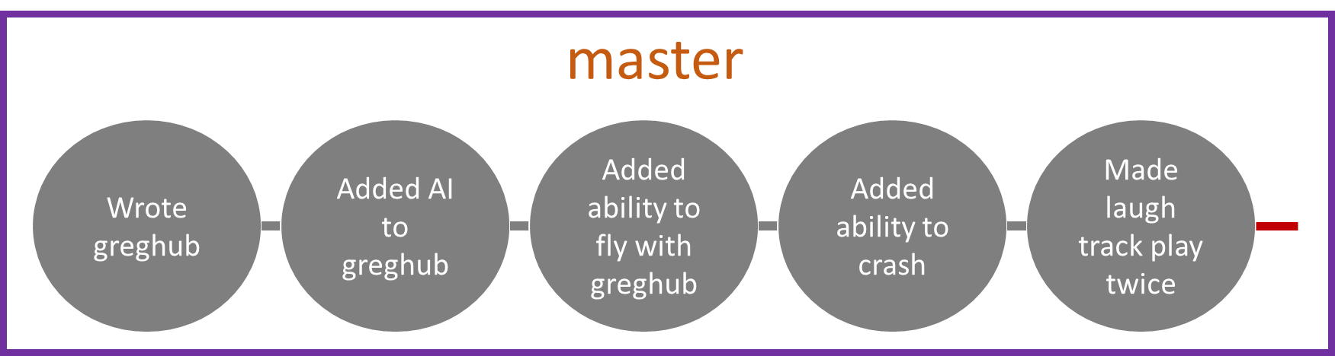
Bye branches
Linearize master
Delete my old branches
My repo now looks like this
lol yes

Slide 42
Conflict resolution
When merge can’t reconcile changes
HEAD stays the same
MERGE_HEAD is set to other branch
Paths that merged cleanly are updated in index and working tree
For conflicting paths, index gets 3 versions (common ancestor, HEAD, and MERGE_HEAD)
Working files contain merge result:
<<<<<<< yours:sample.txt
the merge to part
=======
the merge from part
>>>>>>> theirs:sample.txt
git merge --abort = only usable after a failed merge, will reset to pre-merge attempt

Slide 43
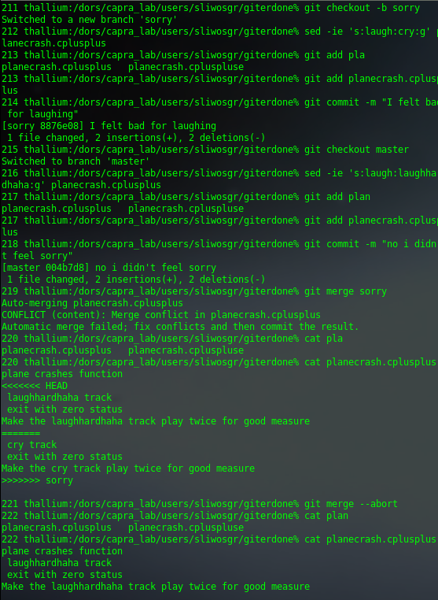
Indecisive Greg
3. I can’t decide!
1. Cry instead of laugh?
2. Hell no, laugh harder
4. Oh to hell with it, laugh harder it is

Slide 44
Tips for resolving conflicts
Use a tool such as git mergetool or a visual tool (kdiff3)
A common setting is `git config --global merge.conflictstyle diff3`
This shows the code at their common ancestor when looking at conflicting sections (|||)
If you have a lot of conflicts in a long piece of content, try git merge --strategy-option=patience
http://git.661346.n2.nabble.com/Bram-Cohen-speaks-up-about-patience-diff-td2277041.html
SourceTree is also a good git gui that can help with conflicts
https://www.sourcetreeapp.com/
Hear from other devs
https://developer.atlassian.com/blog/2015/12/tips-tools-to-solve-git-conflicts/

Slide 45

It was like that when I got here: rebasing
git rebase <source>
Alternative to merge with cleaner history
Common scenario
You start working on a new feature
Someone updates the master branch
You want to merge those into your feature branch (no conflicts)
Merging will create a commit
You keep merging new changes = more and more commits
When you rebase instead of merge
Your feature branch is moved to the tip of master
It’s as if you started your branch where master is now rather than then
You just rewrote history
lol don’t do this to public repo’s

Slide 46
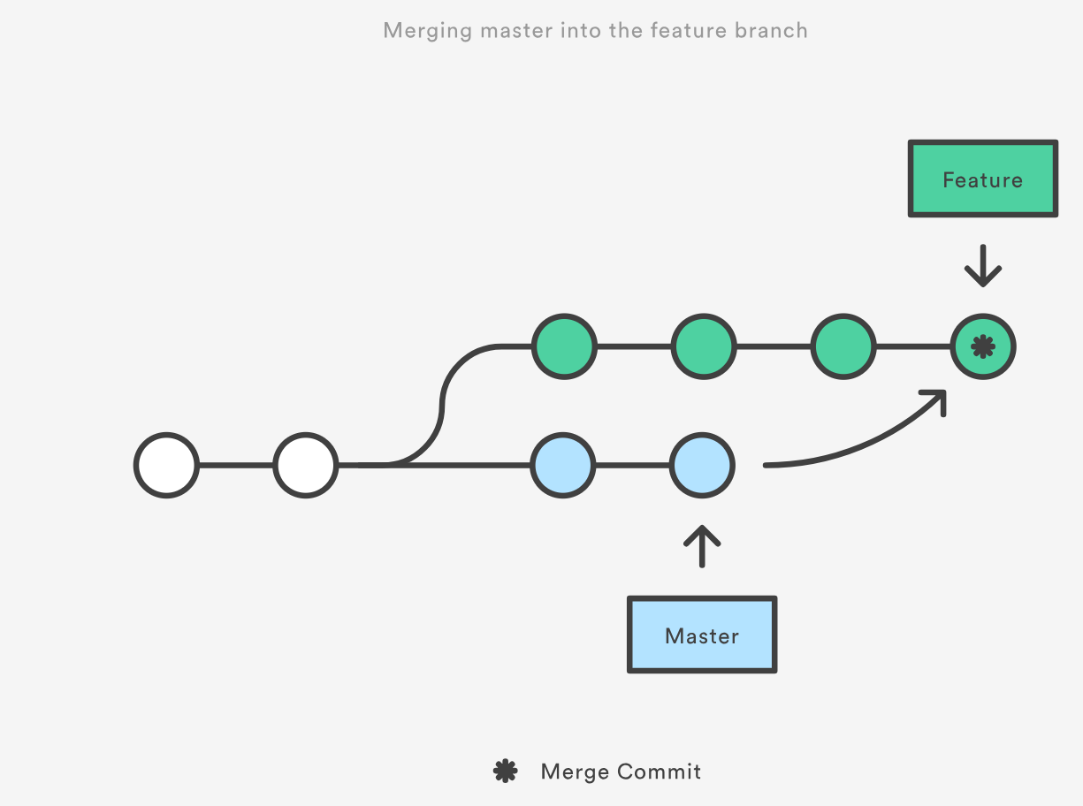
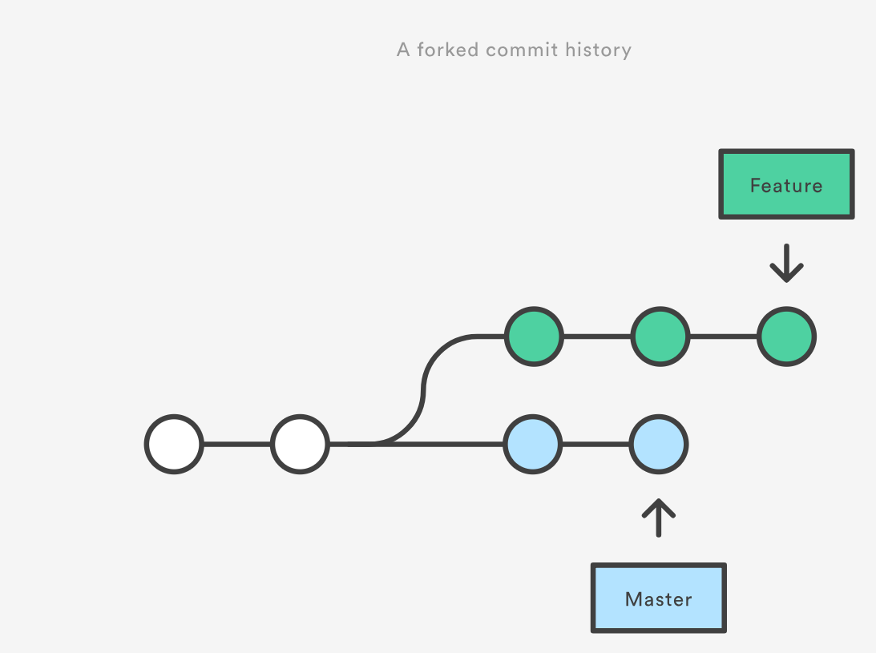
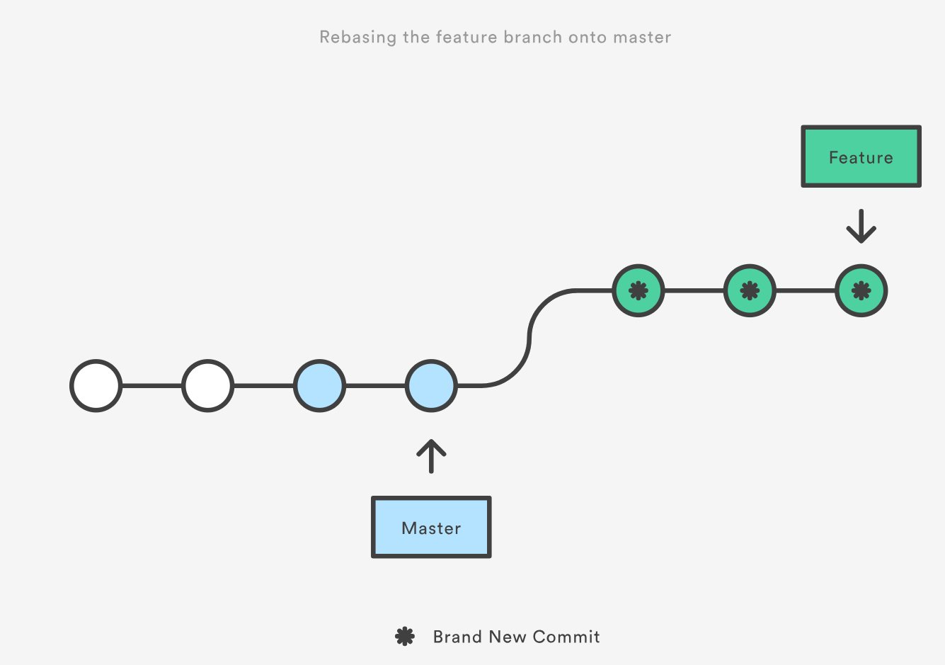
Rebase vs Merge

Slide 47
How to view your project history
git log
-n = show n commits
--oneline = condense each commit to one line
you did summarize with 50 char or less right?
-p show complete diff of each commit (most detailed view possible)
--grep=“<pattern>” = search commit messages (-i to ignore case)
You detailed them right?
<since>..<until>
--after=“2014-7-1” or =“yesterday” or “1 week ago”
-- <filename> = for a single file
<branchname> = history of a particular branch
The pickax: -S”<string>” or –G”<regex>” = search for a particular line of code

Slide 48
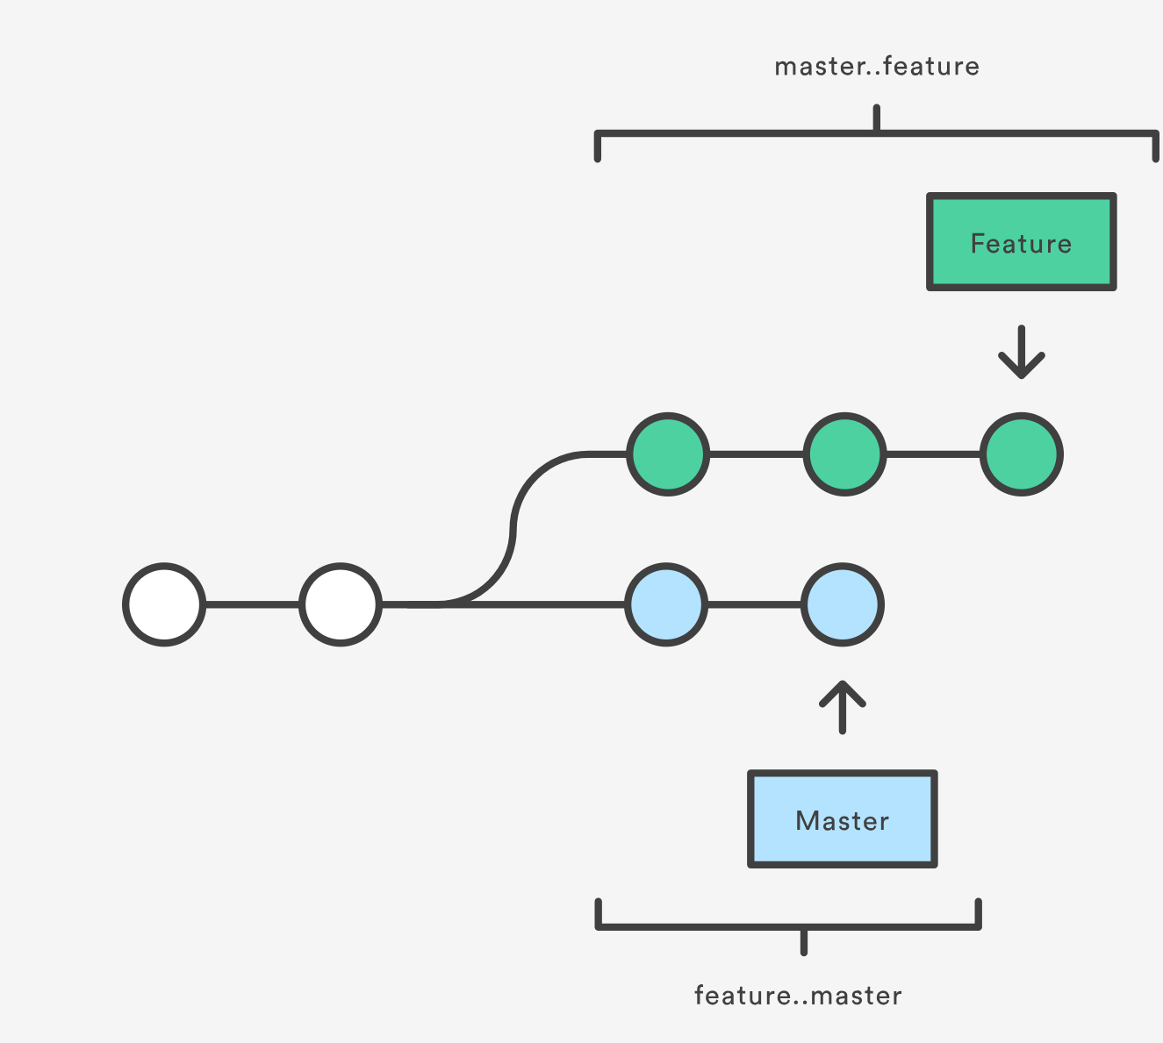
Looking at progress differences between branches
git log master..feature
How far feature has progressed
git log feature..master
How the master has changed
since the feature began
For complex histories, there are a ton of visualization tools (gitk or sourcetree)

Slide 49
Comparing snapshots/files/branches
git diff
Compare 2 things:
Default: any uncommitted changes since last commit
2 branchs: git diff branch1..branch2
2 Files between branches: git diff branch1 branch2 ./filename.txt
Working directory against index: git diff ./path/to/file
2 refs
Default is to compare against HEAD
Get refs to compare against using git log
Often you want to preview changes before merging: git diff <source_branch> <target_branch>

Slide 50
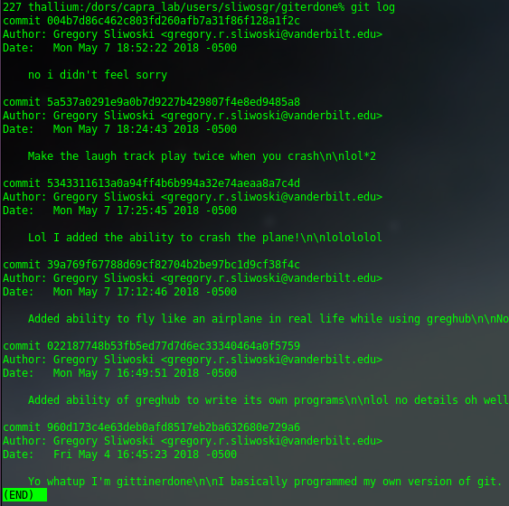
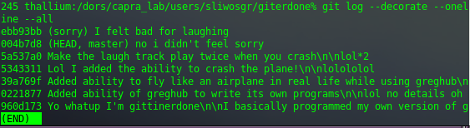
Man my project has really devolved

Slide 51
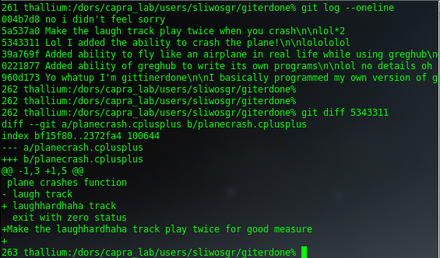
Where did it all go so wrong?
Oh yeah, I added the ability for my users to crash, literally.
Ohhhh, I laughed at them too. Oops.
Okay, this is bad.

Slide 52
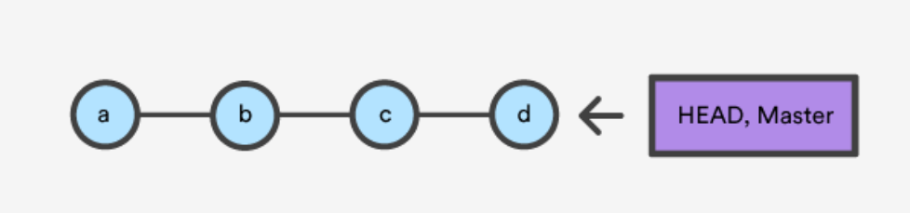
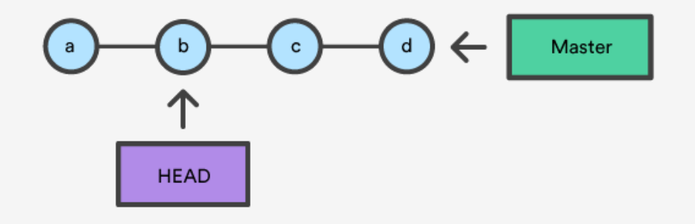
Time traveling in git
Technically there’s no such thing as an ‘undo’ in git.
Every action is a snapshot of a point in time, even undoing a change
Simple time travel
a) Look at an old version
git log to get SHA1
git checkout SHA1 (detached HEAD)
Look around
git checkout master (or whatever branch you were on to go back)
b) Amend a commit
You forgot to add a file or want to change the last commit message
git commit –amend
c) Revert a file you changed poorly
git checkout <commit_version> -- <filename>
-- tells git it’s a file not a branch, unnecessary if no branch with that name
Only changed in working dir: followed by git add <filename>; git commit to keep changes
git checkout b

Slide 53
Undoing commits in git
The bad way:
git checkout a previous version
Git checkout –b new_branch to move the detached HEAD to a new branch.
Go ahead and do your thing and merge it back to master
The good way:
git revert – public
git reset – private

Slide 54
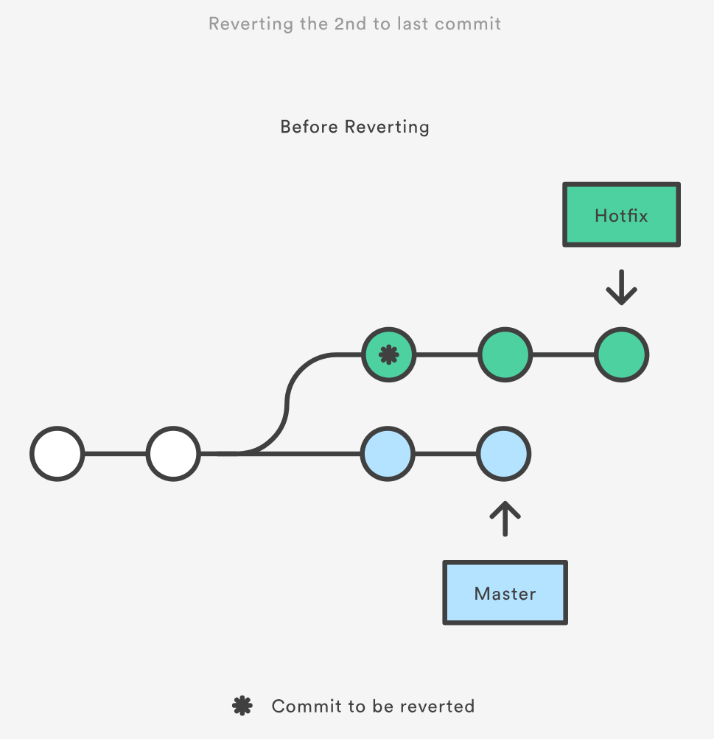
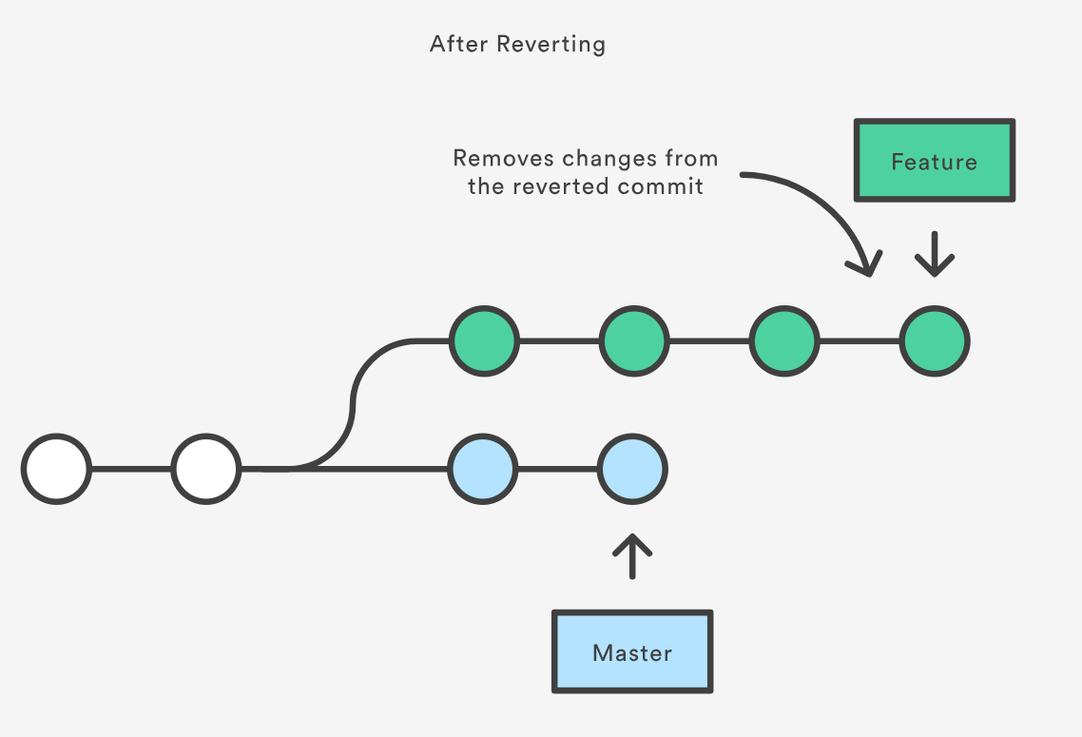
Undoing public commits
git revert <commit>
git revert HEAD = creates new commit that is exact inverse of the last commit
preserves history
No file level functionality (only works on commits)
Only reverts changes in specified commit (not all in between)
Specify range with commit1..commit2
-n just add changes to staging index and working dir, don’t commit yet
1. git checkout hotfix
2. git revert HEAD~2

Slide 55
Checkout vs Revert
Function | Commit Scope | File Scope
checkout | switch between branches or inspect old snapshots | Discard changes in working directory
revert | Undo commits in a branch | N/A

Slide 56
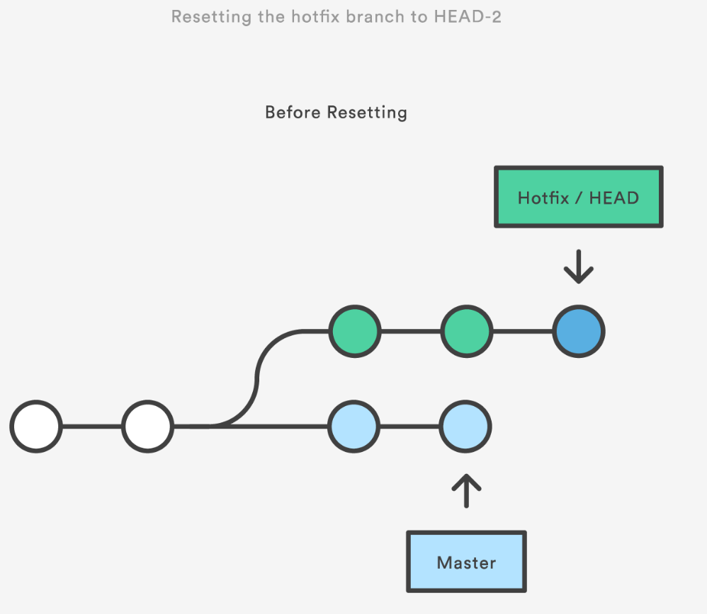
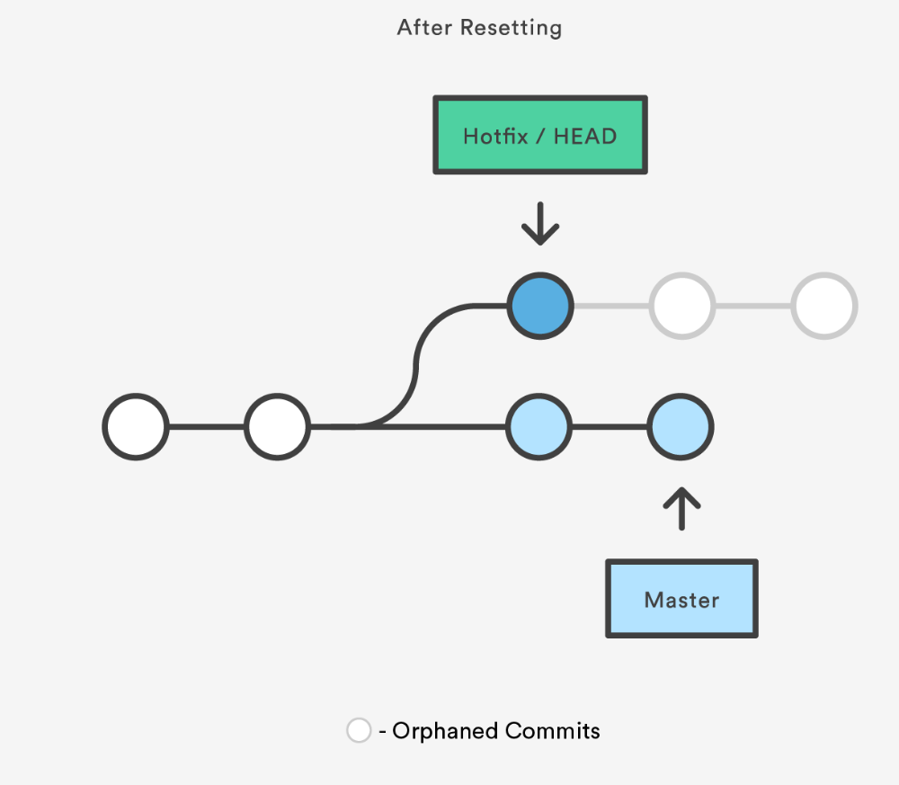
Undoing private changes
Git reset <commit>
Commit history is erased after the <commit>.
Will reverse all changes after the given commit (unlike revert)
Those commits are orphaned and will be deleted as garbage
*Git reset <file> just unstages a file (opposite of git add <file>)
git reset HEAD~2

Slide 57
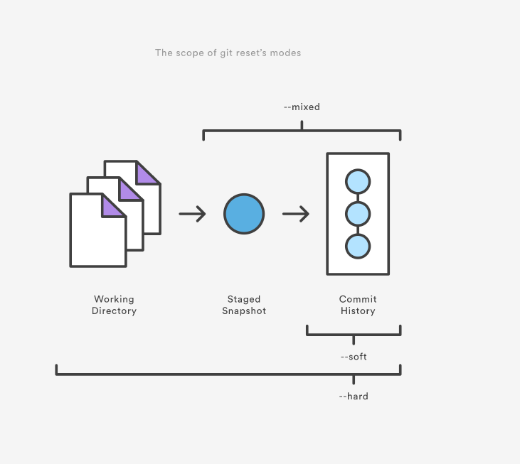
3 Forms of reset
git reset always moves HEAD, but what else it changes is up to you
--soft = commit tree only
--mixed = commit tree and staging index [default]
--hard = all 3 trees
Examples:
git reset = reset staging area to match most recent commit but leave working dir unchanged.
git reset <commit> = move current branch tip backward to commit, reset the staging area to match, but leave working dir alone. All changes made since commit will reside in the working dir.

Slide 58
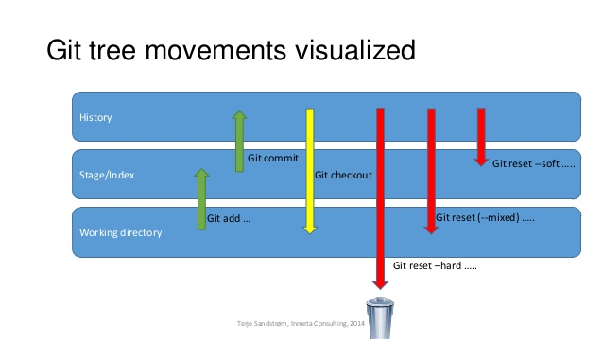

Slide 59
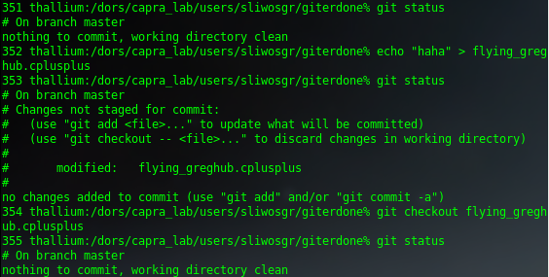
Quick fixes to a single file
Undo all your edits: git checkout filename

Slide 60
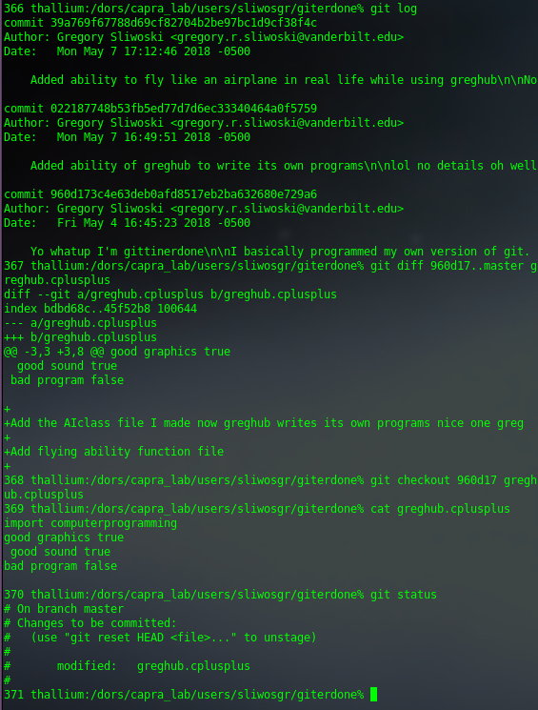
Quick fixes to a single file
2. Change it to a previous version: git checkout commitID filename
*You can always look at differences first with git diff ID1..ID2 filename

Slide 61
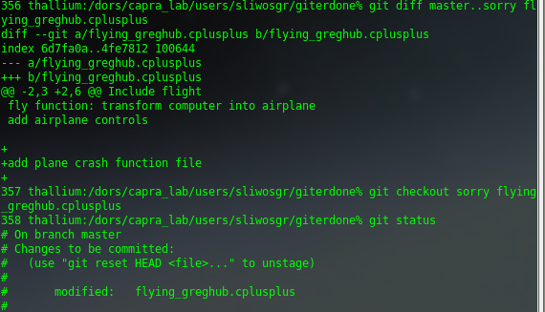
Quick fixes to a single file
3. Change it to a version on a different branch: git checkout branchname filename

Slide 62
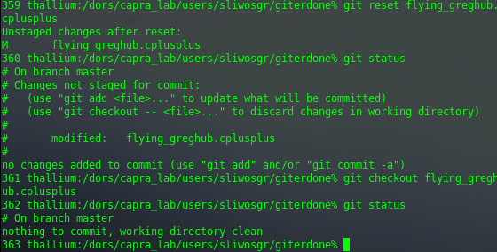
Quick fixes to a single file
4. Unstage the file: git reset filename
5. Go back to the original version (before I started these examples):

Slide 63

Getting back to happier times
No one will ever know… right?

Slide 64
In case of emergency, break reflog
git reflog = reference logs
records every single update to a branch tip, including resets and checkouts
Stores everything, committed or not
Default is expire after 90 days
Stored in dirs: git/logs/refs/heads, .git/logs/HEAD, and .git/logs/refs/stash
--all = get a complete reflog
show otherbranch = show a specific branch
HEAD{<n>} works a lot like HEAD~<n>
Example:
you left some commits orphaned after a git reset.
Access them with HEAD@{1}
puts you in detached head state so create new branch to continue working

Slide 65


Oh god they know

Slide 66
Some advanced things you might use
Stashing unfinished changes
git stash
Changing default behavior
git config
Ignoring unprocessed datasets or other files in your git repo
git ignore
Figure out if it was Souhrid who broke the pipeline
git blame

Slide 67
Stashing changes
Scenario
Working on feature
There’s a bug in the main program
Changes not ready for commit but need to switch to master real quick
Stash the changes temporarily so you can fix the bug and come back
git stash – save changes (working dir and stage) them for later use.*
git stash pop – reapply staged changes and remove stash
git stash apply – same but keep stash (if applying to multiple branches)
-p = interactive mode, select which chunks to stash
git stash drop = delete stash
*By default git will not stash untracked (new) or ignored files (use –u to stash untracked files, -a include ignored)

Slide 68


I’m working on a new class
Something’s broken so stash my progress
Back to before my changes
Fix my bugs, add, commit, etc.
Bring back my stash

Slide 69
Stashes continued
Multiple stashes are possible
run git stash several times
git stash list to view them
git stash save “message” = provide context to a stash
git stash pop stash@{<n>} = select a specific stash
git stash clear = delete all stashes
Encoded in repo as commit objects
.git/refs/stash points to most recently created stash
Stash has its own reflog to refer to previous stashes
Since stashes are essentially commits to, you can inspect them with git log
Running git stash creates 2 or 3 new commits:
a new commit to store tracked files in working copy
a pre-existing commit that was at HEAD when you ran stash
a new commit representing the index when you ran stash
(if you used –u or –a) a new commit of untracked files

Slide 70
Configuring git
All options are held in a 3 plaintext files
<reponame>/.git/config = repo specific --local
~/.gitconfig = global settings for all local git repos --global
/etc/gitconfig = system wide settings (admin) --system
You can directly edit config files
git config = convenience command for changing config files
Commonly used to define aliases for commands
git config –global alias.ci commit = creates an alias for commit so “git ci” can be used instead

Slide 71


Slide 72
Ignore files
3 File States:
Tracked – previously staged or committed
Untracked – never staged or committed (new files)
Ignored – ignored by git
.gitignore = contains a list of ignored files. Must add to it manually.
Can use globbing (*,?, [0-9], etc)
Include comments in ignore with #
Prepend pattern with ** to match directories
Force git add to include an ignored file with –f <ignored_file>

Slide 73

git blame
Display author metadata attached to specific committed lines in a file
Often used with a GUI display and hosting sites (Github) typically have pretty wrappers for this.
operates on individual files only.
Columns are id, author, timestamp, line number, line content
Ignore whitespace changes with –w
Get the original author of a line that has been moved (instead of seeing the person who moved it): -M from same file, -C from other file
Git blame is typically used to see who last edited a line. Further history is more convenient with git log. (git log –S “show me where this code was added or modified all through history”)

Slide 74


Slide 75


Collaborating with git
Git is distributed (unlike SVN which is centralized)
Git makes no distinction between original and cloned repo’s

Slide 76
Getting started
git clone <url>
Copies a remote repo onto local machine (completely isolated)
git clone --depth n <repo> = only clone history of depth n
repo’s with extensive histories
git clone --branch = clone specified branch (not the one HEAD points to)
runs git init <reponame>
copies all history from remote
creates ‘origin’ ref which is remote connection back to source (in refs/remotes/origin)
initializes remote.origin.url and remote.origin.fetch config var
generally only need to run it once

Slide 77
What is origin?
‘origin’ is the alias for the url of original clone
Stored in .git/config file
Not created automatically with git init
Can add any alias to config manually or with
git remote add <name> <url>
git remote rm <name> = remove a connection
Nothing automatically flows between repos even if you have a remote set up, it’s just an alias

Slide 78
Collaborating with git
Getting changes:
git pull or git fetch
Sending changes:
git push
Pushing branches to remote repos:
git remote add new-remote-repo <url>
git push new-remote-repo branch
delete a remote branch
git push origin --delete bad_branch or
git push origin :bad_branch

Slide 79
Pushing changes
git push <remote> <branch>
`git push origin master` = pushing to master branch on origin (the server)
Essentially the same as running `git merge master` from inside the remote repo
change master to whatever branch you to want to push changes to
A branch is not available to others unless you push it to your remote repo (git push origin <branch>)
When you commit a file, you have committed to HEAD but it’s not in the remote repo yet. This is what push is for.
Will not push if a fast-forward merge is not possible (--force)
--all = push all branches

Slide 80
Example uses of git push
Default use of push
Git checkout master; git fetch origin master = make sure local master is up to date
Git rebase –i origin/master =Rebase changes on top of central repo’s copy
Also opportunity to clean up commits before sharing them
Git push origin master = send all commits on local master to central repo
Amended force push
Git commit --amend
Git push --force origin master
Deleting remote branch or tag
Git branch –D branch_name
Git push origin :branch_name

Slide 81
Steps you might need to take
If you get request failed and url is https:
Use this url instead git@github.com:username/reponame
If you get permission denied (publickey) you need to add the SSH key to your github account
Create an SSH key:
cd ~/.ssh
ssh-keygen
Hit enter for all the defaults, will create a new file called id_rsa.pub (or whatever you name it for non-default)
Add key to your github account:
Go to https://github.com/settings/keys
New SSH key
Copy and paste the contents of id_rsa.pub
Type in consol:
ssh –T git@github.com

Slide 82



Slide 83


Pulling changes
git pull
often used without any parameters
--all = pull all changes from server and merge into local repo with single command
pull is a combination of git fetch followed by git merge.
Pull will download all changes from point where local and master diverged (E)
New commit (H) is a new merge commit that contains contents of remote A-B-C commits and has a combined log message

Slide 84


Slide 85

Keeping up-to-date with rebase
Instead of pulling with merge, use rebase to keep things clean
You clone and start a feature branch
The origin master branch progresses while you’re working
You want to get updates but don’t want to clutter history
Pull with merge would add unnecessary merge commits every time you pull
Use git pull --rebase
To be careful, you can use –i for interactive rebase
Rebase often to avoid conflicts when origin master has gone too far
git config --global branch.autosetuprebase always = always rebase instead of merge with pull

Slide 86

git fetch (step 1 of git pull)
Downloads changes but doesn’t merge them
Lets you see how central repo has progressed but doesn’t force you to merge the changes into your repo.
Fetched content must be explicitly checked out using git checkout
Safe way to review commits before integrating them with local repo.
All commits, local and remote are stored in the repo’s .git/objects directory but remote and local branch commits are kept distinctly separate through use of branch refs. Local refs are stored in .git/refs/heads
Remote branches are just like local branches except they map to commits from somebody else’s repo and are prefixed by the remote they belong and are found in .git/refs/remotes
git branch –r (shows all branches: local are prefixed with origin, remote branches are prefixed with remote-repo/
You can checkout a remote branch just like a local one but this puts you in a detached HEAD state (like checking out an old local commit).
Ex: drop all local changes and commits:
git fetch origin
git reset --hard origin/master
Squares = commits downloaded from repo
Blue circle = your master

Slide 87
Forking
Create your own public copy of a public repo
Forking comes in because you typically have read access to another’s public repo but not write access. Once you fork, clone, change, push, you can create pull request to write to it.
Forking is another way of saving a clone or copy. Unlike branch, fork is independent from original repo. If original repo is deleted, fork remains. If you fork a repo, you get that repo and all of its branches.

Slide 88
Pull Request
Ask another dev to merge one of your branches into their repo.
Essentially a comment thread attached to a feature branch.
Can be used when a dev gets stuck to ask for help from rest of team.
Formal code review, other devs can push changes
Pull Request Workflow
Dev creates feature branch in local repo
Dev pushes branch to public repo
Dev files a pull request
Rest of team reviews code, discusses it, and alters it
Project maintainer merges feature and closes pull request

Slide 89
Git LFS
Working with large files. Downloads relevant versions lazily (large files downloaded during checkout rather than during cloning or fetching)
Replaces large files with pointer files.
LFS is seamless so you use it without changing anything about your workflow.
To use git LFS, use a git LFS aware host, most are, and have the git LFS command-line client installed:
https://git-lfs.github.com/

Slide 90
Github
Code hosting platform for version control and collaboration
Repo = a single project, can contain folders and files, images, videos, datasets, anything your project needs
Recommended to include a README or a file with info about your project (Github will prompt for a README when you create a new repo)

Slide 91

Creating a public repo on Github
Click + next to avatar and select New Repository

Slide 92

Doing things on Github
You can do most things from command line with buttons (create new branches, files, etc.
README is always displayed at project root
README uses markdown

Slide 93

Linking to a fresh github repo
This is your reference (origin when you clone)

Slide 94

Wow a fancy git log (AKA I prefer to click on stuff)

Slide 95

Wow you can look at files by clicking on them

Slide 96

Wow you can edit files on github (aka vim sucks)

Slide 97


Pull requests are easy on github

Slide 98

GITERDONE IS OFFICIAL

Slide 99


A pull request already?
Nice BUG!!!!! YOU FAILED

Slide 100



Slide 101
Github beyond repo’s
Social Networking
Follow someone and get notified when they do stuff
Every profile has a follow button
Watch a specific project to get notified when it changes
Every project page has a watch button
Explore project that have been starred by people you follow, github staff, and general trending repos
The explore page is your news feed
Inform people on your project with the wiki that comes with every repo
Bug tracking
Use Issues to keep track of tasks, enhancements and bugs
Citing your code
Archive a github repo and get an assigned DOI citation reference

Slide 102
Citing your repo with Zenodo
Add a license to your repo to tell people how they can use it
www.choosealicense.com
Log in to Zenodo with your github credentials
Add the repo (must be public) so Zenodo can implement necessary webhooks for archiving and DOI-issuing
Click the ‘on’ switch for your repo on Zenodo (this adds the webhook)
Create a release (the release button on github)
By default, Zenodo takes an archive of your repo each time you create a new release
If you haven’t created a release yet, you will be asked to create one
There is a new release form you fill in (description, etc)

Slide 103




Creating a release and getting a DOI
1
2
3. Zenodo was just triggered to archive the repo
4. Publish on Zenodo
5. Get your DOI

